Slide 1
Gauteng Xamarin UG
Choosing the correct framework/architecture for my next x-platform app.
Dustyn Lightfoot
dustyn@code27.net
@dustynlightfoot

Slide 2

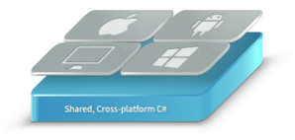

Agenda
Goal of Session
Decision Framework
MVVM
Frameworks
Solutions
Conclusions
Notes:
After last weeks spirited discussion around Forms and IoC – this would be a good subject. Expose to what it out there – not to be too prescriptive but give food for thought and get conversation going.

Slide 3
What is the correct architecture?

Slide 4
… it depends!

Slide 5

Decision Framework
Reuse
Performance
Level of UI control
Learning Curve
Warm and Fuzzy factor
- Documentation
- Community / Backing
- Momentum
- OSS or big company?
Notes:
ATAM (architecture trade-off analysis method) SEI at Carnegie Mellon University. Utility tree with prioritised non-functional goals. Great way to analyse any architecture.

Slide 6
Decision Framework
Create detailed scenarios
- E.g. specific screen render time or % re-use goal
Assign priorities to the qualities
- Try not have the same priority for any
Analyse each candidate architecture in light of the attribute utility tree.

Slide 7
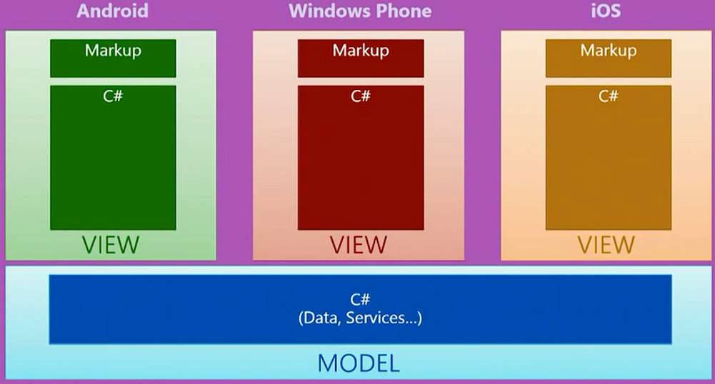
Classic Xamarin Approach
Notes:
Lot of un-testable code, and a lot of un-shareable code.

Slide 8
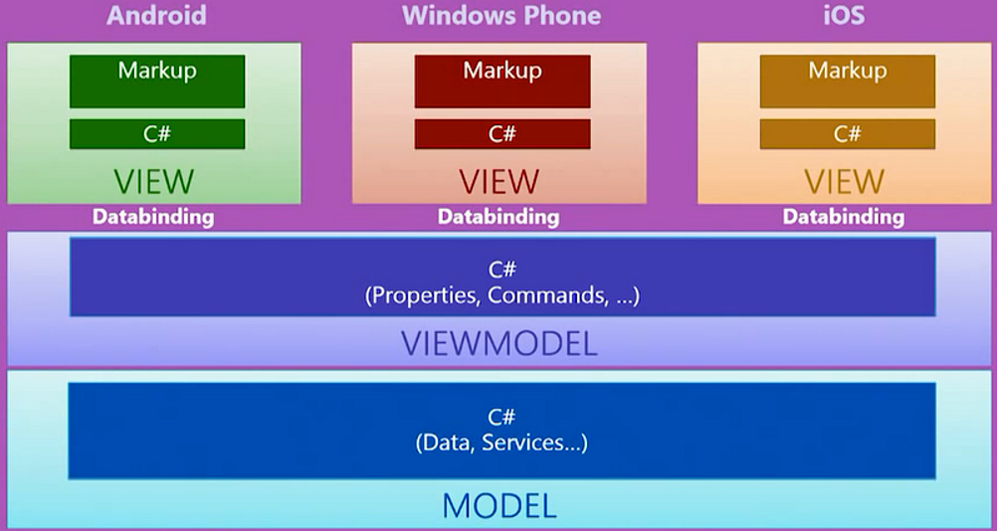
Enter MVVM
Notes:
Explain ViewModel – Abstraction of user interface in terms of commands, properties, events etc. Communicates with UI using databinding and commanding.

Slide 9
What’s in an MVVM Framework
Commanding
INotifyPropertyChanged
Binding
EventBus (Messenger)
IoC

Slide 10
Advantages of MVVM
Separation of concerns
– easier to extend and maintain code.
Better for collaboration
– different roles / teams can focus on different bits.
Better for testing
– much easier to write unit tests against ViewModel
Better support for design process
– decoupled architecture supports design time data

Slide 11
Disadvantages of MVVM
Learning curve
Dependence on 3rd party
Performance

Slide 12
MVVM Frameworks
Xamarin Forms (MVVM bits)
MvvmCross
MVVM Light
Prism
– preview support for Forms
Caliburn Micro
– busy working on Xamarin support (see announcement )

Slide 13
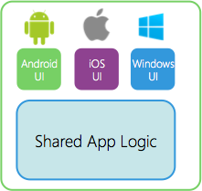
MvvmCross
What is it?
How do we code UI?
Mvvm, Bindings etc.

Slide 14
About MVVMCross
MvvmCross is an open source framework create by Stuart Lodge - @slodge.
Based on Model-View-ViewModel design pattern.
Designed to enhance code reuse across Xamarin.iOS, Xamarin.Android, WP, Windows Store, WPF and Xamarin.Mac.
Available on GitHub - https://github.com/MvvmCross/MvvmCross
as well as - http://slodge.blogspot.com
VS Extension - https://visualstudiogallery.msdn.microsoft.com/618b51f0-6de8-4f85-95ce-a50c658c7767

Slide 15
MvvmCross Views
Are implemented using platform specific constructs
iOS - MvxViewController
Android - MvxActivity / MvxFragment

Slide 16
ViewModels
Data is exposed to the View as properties on the ViewModel
Uses the MvxViewModel base class
ViewModels exposes logic that can be invoked from the View - Architecture base on ICommand. MvvmCross provides IMvxCommand
Example:
ButtonTapped = new MvxCommand<UGMember> (UGMemberSelectedExec);

Slide 17
Data binding
Facilitates communication between View and ViewModel - 2 way data exchange.
Four Binding Modes
OneWay - ViewModel to View
OneWayToSource - View to ViewModel
TwoWay - ViewModel to View and back
OneTime - Like OneWay, but not monitored by the View

Slide 18
Data Binding
Relies on INotifyPropertyChange
Android
<TextView
android:layout_width="match_parent"
android:layout_height="wrap_content"
android:id="@+id/descrTextView"
local:MvxBind=“Text UGMember.Description" />
iOS
this.CreateBinding (this.descriptionLabel)
.To ((DetailViewModel vm) =>
vm.UGMember.Description)
.Apply ();

Slide 19
Demo

Slide 20
MvvmCross Scorecard
Category | Score
Learning Curve | 2
Platforms Supported | 1
Maturity (docs, samples) | 1
Backing (who, OSS) | 2?
Extras (plugins etc.) | 1

Slide 21
MVVM Light

Slide 22
About MVVM Light
An open source framework create by Laurent Bignion (GalaSoft)
Based on Model-View-ViewModel design pattern.
Designed to enhance code reuse across Xamarin.iOS, Xamarin.Android, WP, Windows Store, Windows 10, WPF – not Mac as far as I can see.
Available on CodePlex - https://mvvmlight.codeplex.com/
as well as - http://www.mvvmlight.net
VS Extension – Search in extensions and updates (templates a bit behind)

Slide 23
Mvvm Light Scorecard
Category | Score
Learning Curve | 1
Platforms Supported | 1-2
Maturity (docs, samples) | 1-2
Backing (who, OSS) | 1-2
Extras (plugins etc.) | 2?

Slide 24
Prism

Slide 25
About Prism
Originally designed for building composite windows applications
MS Patterns an practices team – recently been open sourced (prism detail) and run buy a new team
GitHub - https://github.com/PrismLibrary
Prism for Xamarin.Forms in preview see - prism Xamatin.Forms

Slide 26
Demo
Notes:
1. Create Forms App 2. Add Prism.Forms to all Projects 3. Create Bootstrapper in portable inherit from UnityBootstrapper

Slide 27
Prism Scorecard
Category | Score
Learning Curve | 2
Platforms Supported | 3 (Form only mobile?)
Maturity (docs, samples) | 0 preview
Backing (who, OSS) | 2?
Extras (plugins etc.) | ?

Slide 28
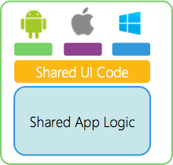
Xamarin.Forms
What is Xamarin.Forms?
How do we code Xamarin.Forms?

Slide 29
What is Xamarin.Forms ?
UI Layer abstraction for iOS, Android and Windows Phone.

Slide 30
using Xamarin.Forms;
var profilePage = new ContentPage {
Title = "Profile",
Icon = "Profile.png",
Content = new StackLayout {
Spacing = 20, Padding = 50,
VerticalOptions = LayoutOptions.Center,
Children = {
new Entry { Placeholder = "Username" },
new Entry { Placeholder = "Password", IsPassword = true },
new Button {
Text = "Login",
TextColor = Color.White,
BackgroundColor = Color.FromHex("77D065") }}}
};
var settingsPage = new ContentPage {
Title = "Settings",
Icon = "Settings.png",
(...)
};
var mainPage = new TabbedPage { Children = { profilePage, settingsPage } };

Slide 31
<?xml version="1.0" encoding="UTF-8"?>
<TabbedPage xmlns="http://xamarin.com/schemas/2014/forms"
xmlns:x="http://schemas.microsoft.com/winfx/2009/xaml"
x:Class="MyApp.MainPage">
<TabbedPage.Children>
<ContentPage Title="Profile" Icon="Profile.png">
<StackLayout Spacing="20" Padding="20"
VerticalOptions="Center">
<Entry Placeholder="Username"
Text="{Binding Username}"/>
<Entry Placeholder="Password"
Text="{Binding Password}"
IsPassword="true"/>
<Button Text="Login" TextColor="White"
BackgroundColor="#77D065"
Command="{Binding LoginCommand}"/>
</StackLayout>
</ContentPage>
<ContentPage Title="Settings" Icon="Settings.png">
<!-- Settings -->
</ContentPage>
</TabbedPage.Children>

Slide 32
XAML
Define views, layouts and bindings in a succinct markup language.
Styles
Behaviours
Triggers
MarkupExtensions
Note: Xamarin.Forms is not compatible with pre-existing XAML visual designers.

Slide 33
Extending Xamarin.Forms
Define your own controls, layouts, pages and cells.
Expose your own platform-specific controls in Xamarin.Forms pages.
Subclass included controls and customise their behaviour

Slide 35
Xamarin Forms (MVVM) Scorecard
Category | Score
Learning Curve | 1
Platforms Supported | 3 (only Forms)
Maturity (docs, samples) | 2
Backing (who, OSS) | 1 (Xamarin)
Extras (plugins etc.) | 2? (but growing fast)

Slide 36
Realistic Solutions
Traditional AKA Xamarin Classic
Traditional with MVVM Framework
Forms – native MVVM
Forms – 3rd party MVVM

Slide 37
Classic Xamarin (no MVVM)
Category | Score
Reuse | 3
UI Control | 1
Performance | 1
Learning Curve | 2 (need to know each platform)
Warm and Fuzzy factor | 1 depending on goals

Slide 38
When do I use Traditional?
Best for:
Apps that require specialized interactions
Apps with highly polished design
Apps that use many platform-specific APIs
Apps where custom UI is more important than code sharing
Apps where performance is paramount

Slide 39
Classic Xamarin (with MVVM)
Category | Score
Reuse | 2
UI Control | 1-2 (depending)
Performance | 1-2
Learning Curve | 2-3
Warm and Fuzzy factor | Depends which framework

Slide 40
When do I use Classic Xamarin with an MVVM framework?
Best for:
Apps that require specialized interactions
Apps with highly polished design
Apps that use many platform-specific APIs
Apps where custom UI is more important than code sharing
If I want to use the Mvvm design pattern

Slide 41
Forms (native MVVM)
Category | Score
Reuse | 1
UI Control | 3
Performance | 3
Learning Curve | 2-3 (custom renderers etc.)
Warm and Fuzzy factor | 2 (early but lots of backing)

Slide 42
When do I use Forms with native MVVM
Best for:
Data entry apps
Prototypes and proofs-of-concept
Apps that require little platform-specific functionality
Apps where code sharing is more important than custom UI
Not targeting non Xamarin platforms (WPF etc.)

Slide 43
Forms (3rd Party MVVM)
Category | Score
Reuse | 1
UI Control | 3 (without custom rendering)
Performance | 3
Learning Curve | 3 (forms + framework)
Warm and Fuzzy factor | Depends on framework

Slide 44
When do I use Forms with 3rd Party MVVM
Best for:
Data entry apps
Prototypes and proofs-of-concept
Apps that require little platform-specific functionality
Apps where code sharing is more important than custom UI
Targeting more platforms
Want access to extra plugins etc.
Have existing investment in the framework and have potential reuse + skillset.

Slide 45
Call to action
Send us your experiences - thoughts

